Slide 1
Automata: The method and The madness
Chapter-1 (continuation)

Slide 2
Contents
Computational model
Basic concepts of automata theory
Classification of formal languages (Chomsky Hierarchy)
Membership problem

Slide 3
Computational Model

Slide 4
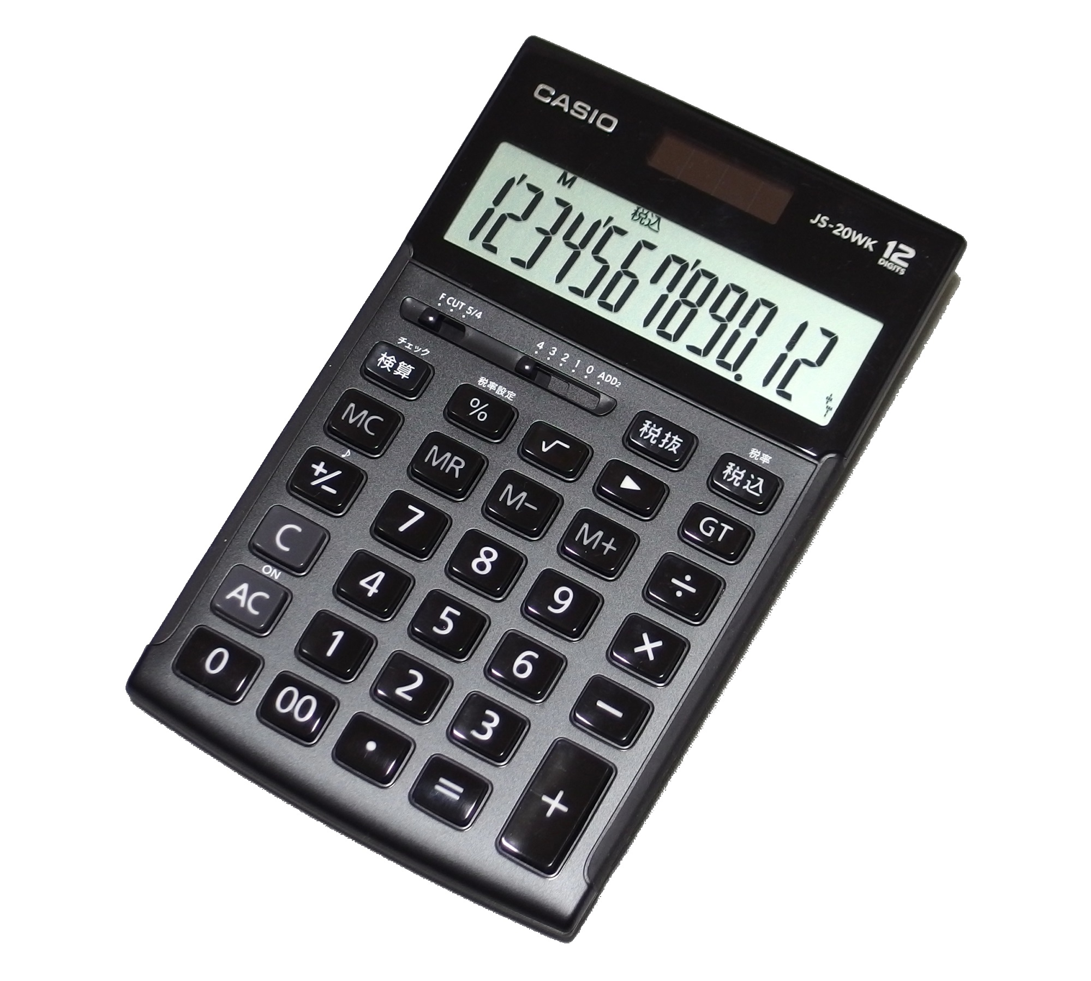
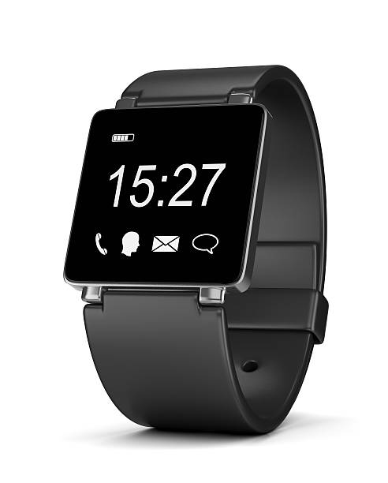


Slide 5
Layers of Automata Theory (Chomsky Hierarchy)
Turing Machine
Linear bounded automata
Pushdown automata
FSM

Slide 6
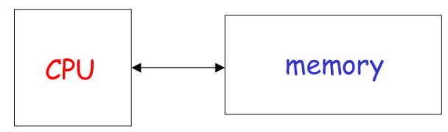
A widely accepted model of computation

Slide 7
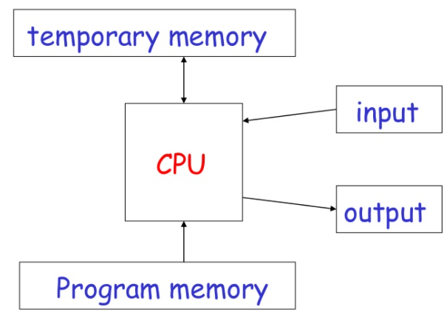
The different components

Slide 8
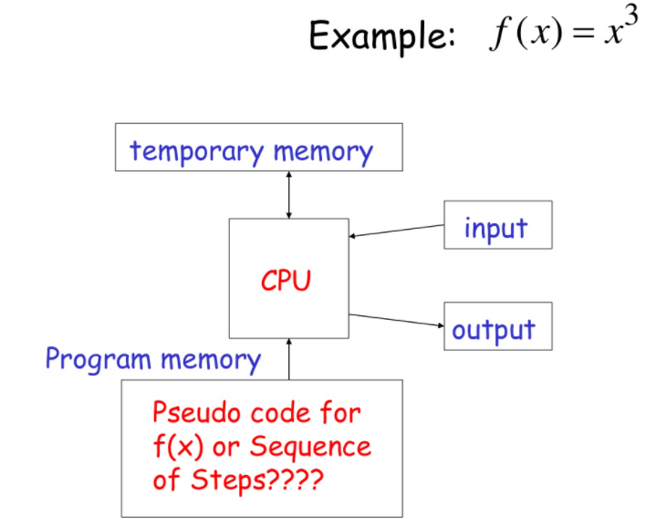

Slide 9
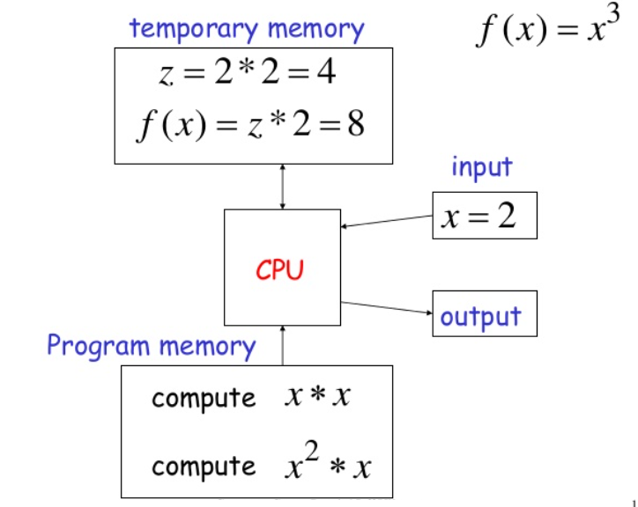

Slide 10
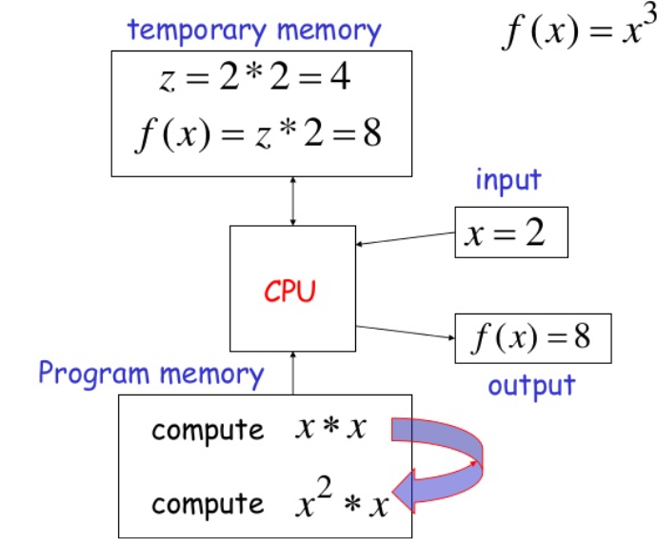

Slide 11
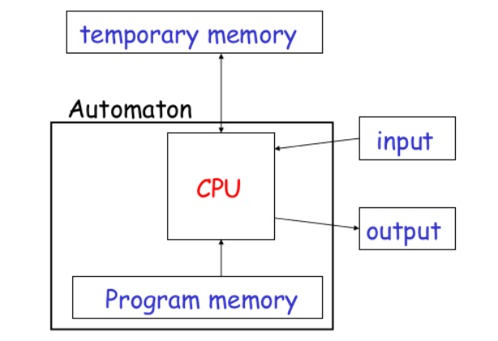
Automaton [IPO]

Slide 12
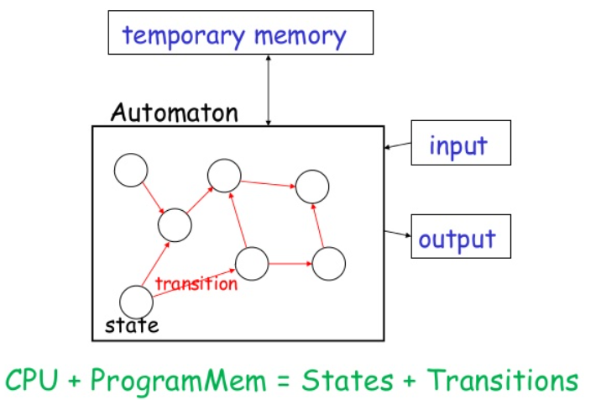
Automaton [Representation]

Slide 13
Different Kinds of Automata
Automata are distinguished by the temporary memory:
Finite Automata: no temporary memory
Pushdown Automata: stack
Turing Machines: random access memory

Slide 14
Memory VS Computational Power
Memory affects computational power:
More flexible memory
Results to
The solution of more computational problems

Slide 15
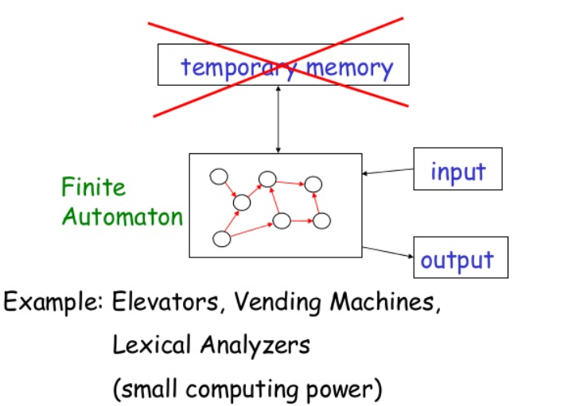
Finite Automaton

Slide 16
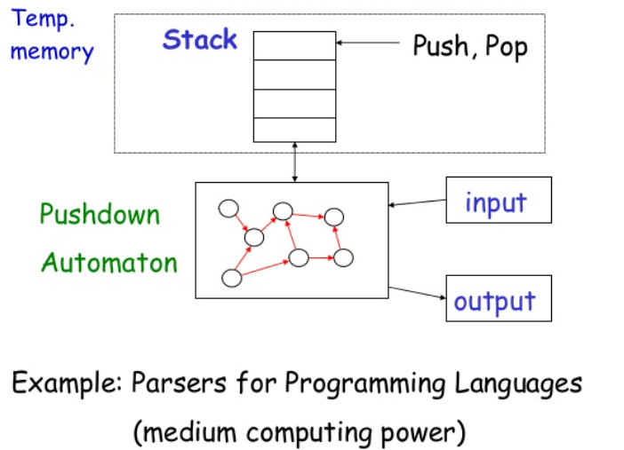
Pushdown Automaton

Slide 17
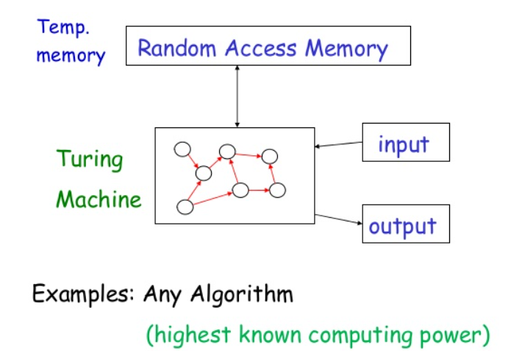
Turing Machine

Slide 18
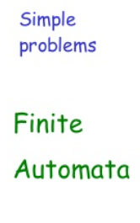
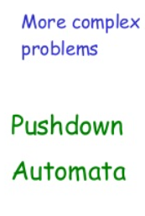
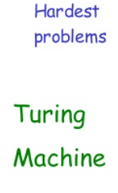

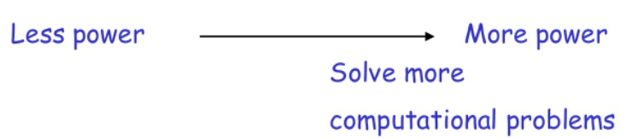
Power of Automata

Slide 19
Power of Automata (cont’d…)
Turing Machine is the most powerful known computational model
Question: can Turing Machines solve all computational problems?
Answer: NO
(there are unsolvable problems)

Slide 20
Central concepts of Automata Theory

Slide 21
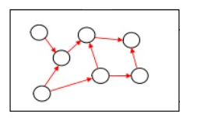
Alphabets
An alphabet is a finite, nonempty set of symbols. The symbol Ʃ is used to denote an alphabet.
Common alphabets include:
Ʃ={0,1}, the binary alphabet
Ʃ={a, b, …, z}, the set of all lower-case letters
The set of all ASCII characters, or the set of all printable ASCII characters.
{0,1,2,…9, 10,11,12,..16,..}
Or
{0,1,00,01,….100,…}
{Yes/No}
Is Prime?
Ʃ={0,1,…,9}
Or
Ʃ={0,1}

Slide 22
Strings
An string (or sometimes word) is a finite sequence of symbols chosen from some alphabet.
For example:
01101 is a string from the binary alphabet, Ʃ={0,1}
111 is another string chosen from the same alphabet
cste is a string chosen from Ʃ={a, b, …, z}

Slide 23
Strings (contd…)
The Empty String
The empty string is the string with zero occurrences of symbols. This string, denoted ɛ, is a string that may be chosen from any alphabet whatsoever.
Length of a String
The number of positions for symbols in the string.
For example, 01101 has length 5.
Notation: The length of a string w is |w|. For example, |011|=3 and | ɛ |=0.

Slide 24
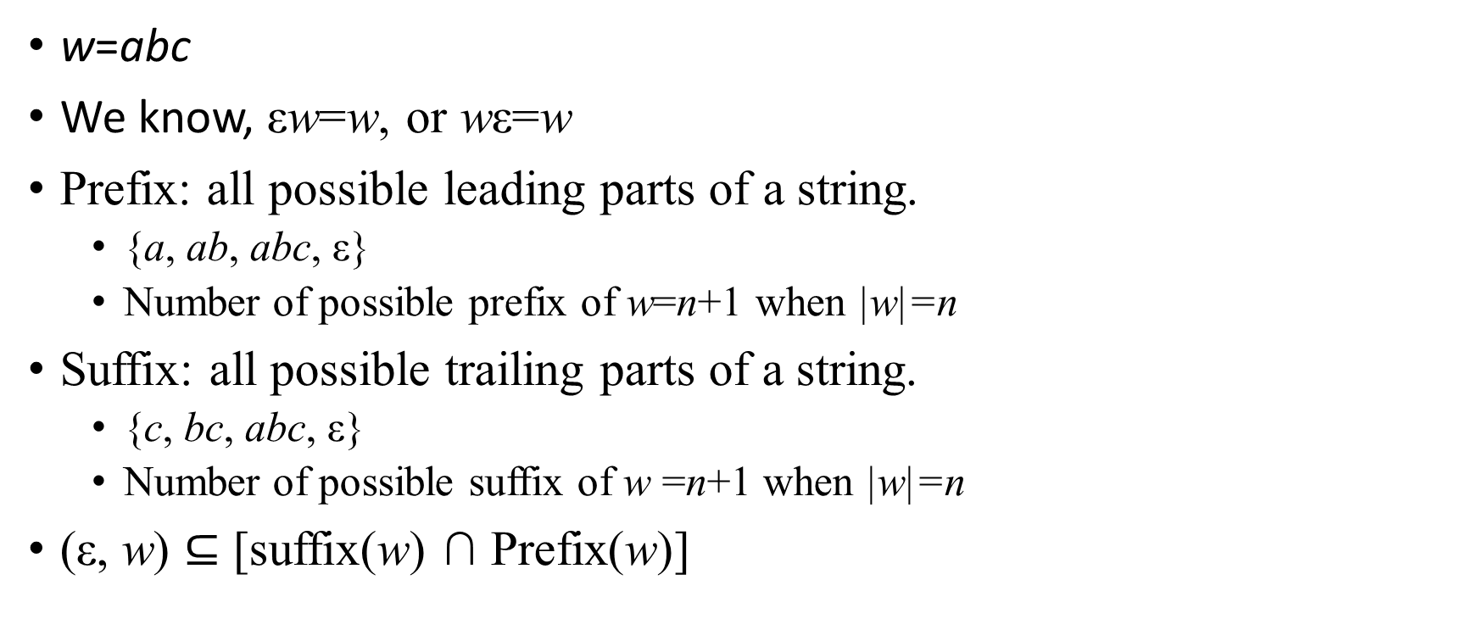
Strings (contd…)
w=abc
We know, εw=w, or wε=w
Prefix: all possible leading parts of a string.
{a, ab, abc, ε}
Number of possible prefix of w=n+1 when |w|=n
Suffix: all possible trailing parts of a string.
{c, bc, abc, ε}
Number of possible suffix of w =n+1 when |w|=n
(ε, w) $⊆$ [suffix(w) ∩ Prefix(w)]

Slide 25
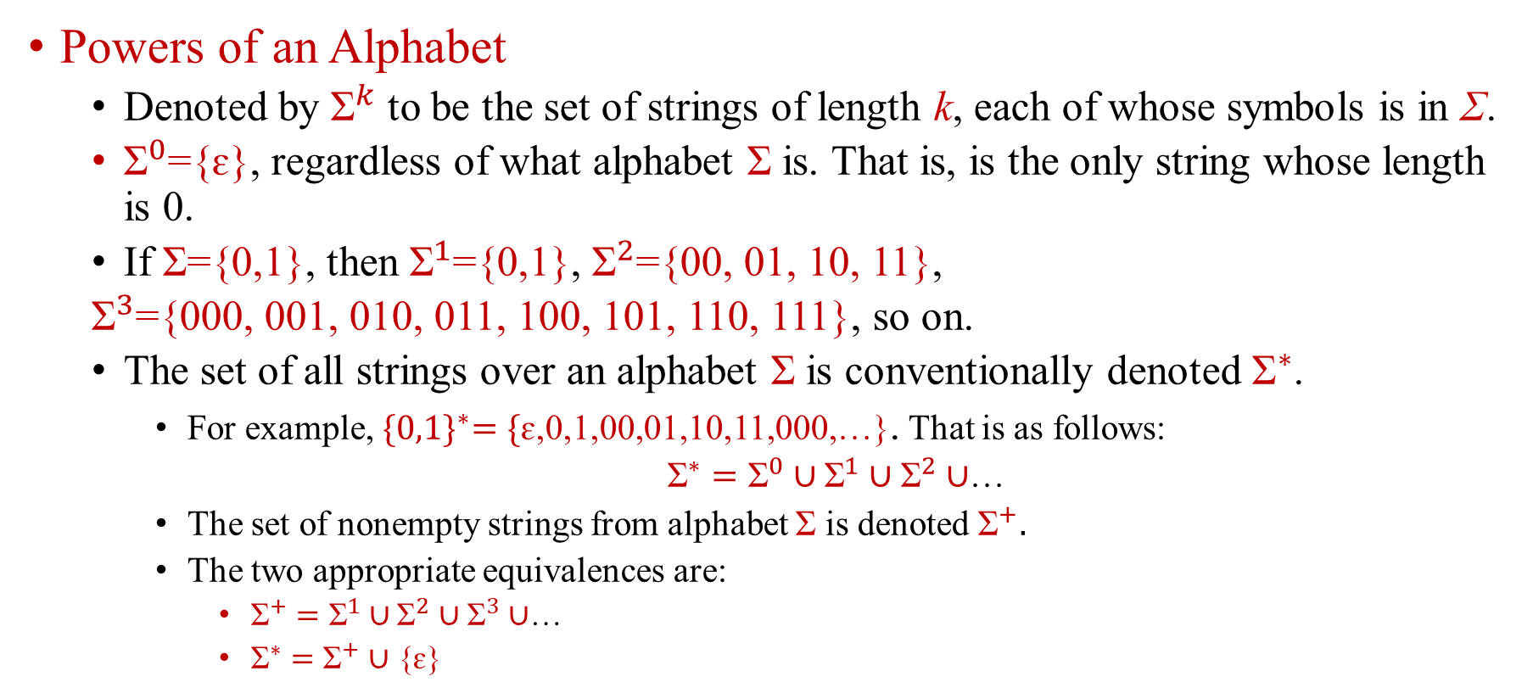
Strings (contd…)
Powers of an Alphabet
Denoted by ${\text{Ʃ}}^{k}$ to be the set of strings of length k, each of whose symbols is in Ʃ.
${\text{Ʃ}}^{0}$={ɛ}, regardless of what alphabet Ʃ is. That is, is the only string whose length is 0.
If Ʃ={0,1}, then ${\text{Ʃ}}^{1}$={0,1}, ${\text{Ʃ}}^{2}$={00, 01, 10, 11},
${\text{Ʃ}}^{3}$={000, 001, 010, 011, 100, 101, 110, 111}, so on.
The set of all strings over an alphabet Ʃ is conventionally denoted ${\text{Ʃ}}^{∗}$.
For example, ${\text{\{0,1\}}}^{∗}=\{$ɛ,0,1,00,01,10,11,000,…}. That is as follows:
${\text{Ʃ}}^{∗}={\text{Ʃ}}^{0}∪{\text{Ʃ}}^{1}$ $∪$ ${\text{Ʃ}}^{2}$ $∪$…
The set of nonempty strings from alphabet Ʃ is denoted ${\text{Ʃ}}^{+}.$
The two appropriate equivalences are:
${\text{Ʃ}}^{+}={\text{Ʃ}}^{1}∪{\text{Ʃ}}^{2}$ $∪$ ${\text{Ʃ}}^{3}$ $∪$…
${\text{Ʃ}}^{∗}={\text{Ʃ}}^{+}$ $∪$ {ɛ}

Slide 26
Strings (contd…)
The concatenation of two strings x and w is denoted by xw, and it is the string formed by the string x followed by the string w.
As a concrete example, consider x = cat, w = nip and the concatenated strings xw = catnip and wx = nipcat.

Slide 27
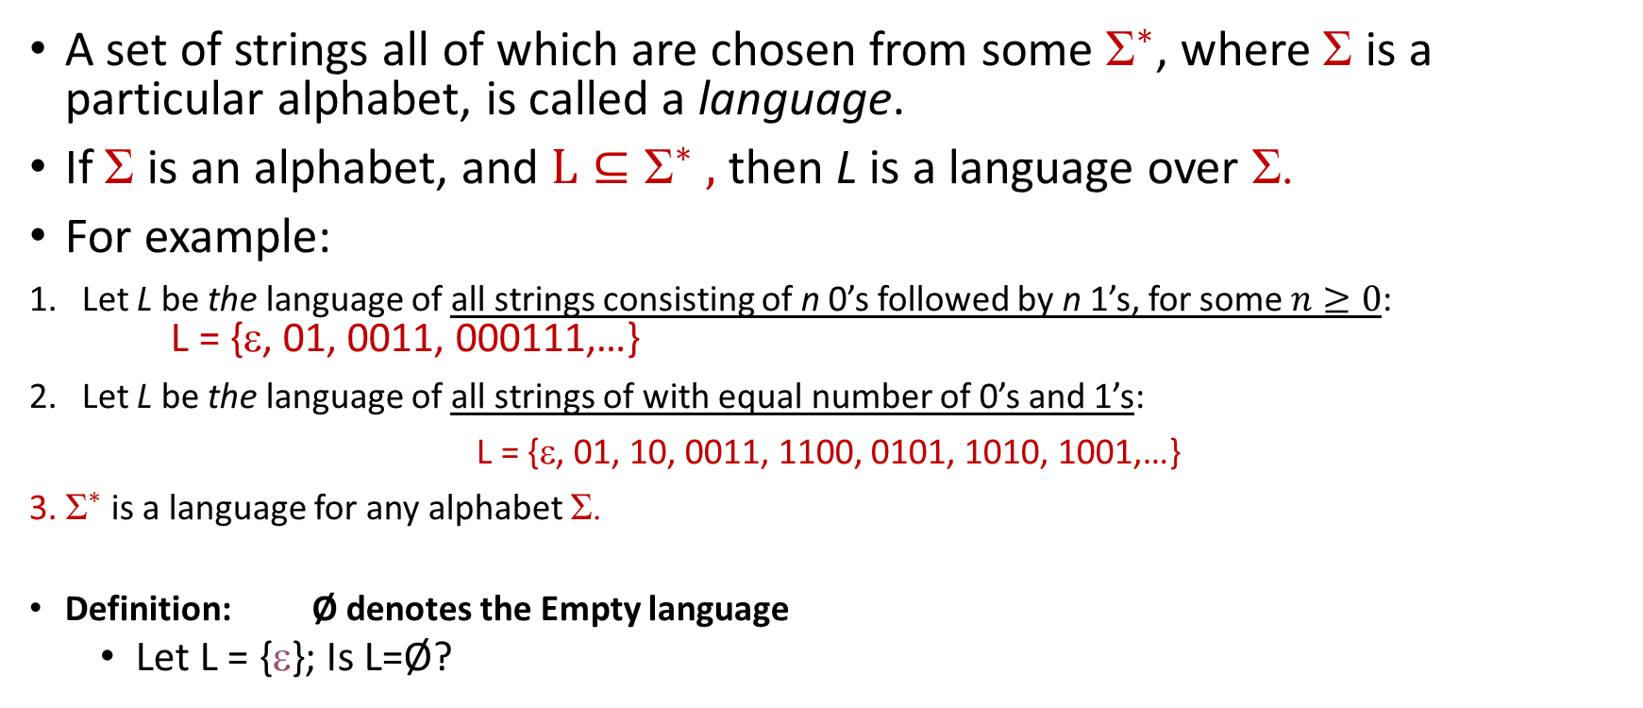
Languages
A set of strings all of which are chosen from some ${\text{Ʃ}}^{∗}$, where Ʃ is a particular alphabet, is called a language.
If Ʃ is an alphabet, and ${\text{L}⊆\text{Ʃ}}^{∗} ,$then L is a language over Ʃ.
For example:
Let L be the language of all strings consisting of n 0’s followed by n 1’s, for some $n≥0$: L = {ε, 01, 0011, 000111,…}
Let L be the language of all strings of with equal number of 0’s and 1’s:
L = {ε, 01, 10, 0011, 1100, 0101, 1010, 1001,…}
3. ${\text{Ʃ}}^{∗}$ is a language for any alphabet Ʃ.
Definition: Ø denotes the Empty language
Let L = {ε}; Is L=Ø?
NO

Slide 28
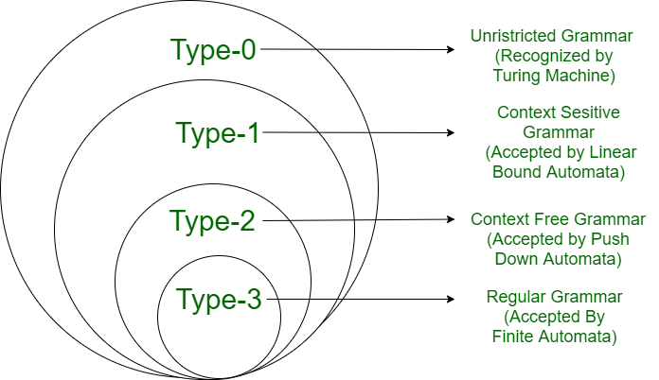
Classification of formal languages
Formal Languages
Type 3
Type 2
Type 1
Type 0
Regular
Languages
Context Free
Languages
Context-Sensitive
Languages
Unrestricted
Languages
0 stack
1 stack
2 bounded stack
2 stack
Finite
Automata
Pushdown
Automata
Linear-bounded
Automata
Turing
Machine
Regular
Grammars
Context Free
Grammars
Context-sensitive
Grammars
Unrestcricted
Grammars

Slide 29
The Membership Problem
In automata theory, a problem is the question of deciding whether a given string is a member of some particular language.
Given a string w ∈ ∑* and a language L over ∑, decide whether or not w ∈L.
Example:
Let w = 100011
Is w ∈ the language of strings with equal number of 0s and 1s?
Let w = 11101
Is w ∈ the language of strings whose value as a binary number is a prime?

Slide 30
Questions?

